Slide 1
Year 8 Information Morning
Mrs Rea – Head of Year 8 Girls and 8V2
Mrs Scott – Head of Year 8 Boys

Slide 2
Purpose of the morning
To develop the home-school link
A chance to meet key staff
Explain pastoral and academic support available in College
Supporting your child/young person in College
Support networks within Laurelhill
Notes:
HSLvital for parents to support young person and College on 5 yr 7yr journey.
Meet FT key pastoral link

Slide 3
Pastoral Support at Laurelhill

Slide 4
Pastoral Support and Points of Contact
Form Tutor – Level 1
- first point of contact for all parent queries
Head of Year – Level 2
- Mrs Rea and Mrs Scott
Senior Teacher for Pastoral Care – Level 3
- Mrs Beckett – responsible for girls
Deputy Principal – Level 3
- Mr Dane – responsible for boys

Slide 5
Safeguarding Team
Designated Teacher for Child Protection
Mr M Dane
Deputy Designated Teacher for Child Protection
Mrs K Beckett
Miss E Collins
Principal – Mr J Martin

Slide 6
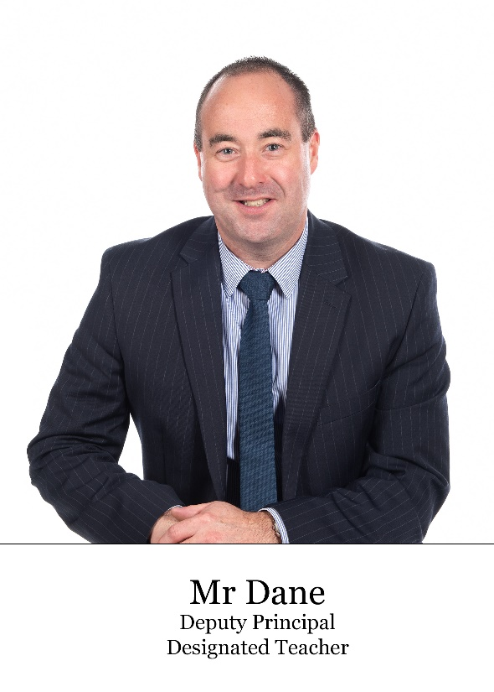
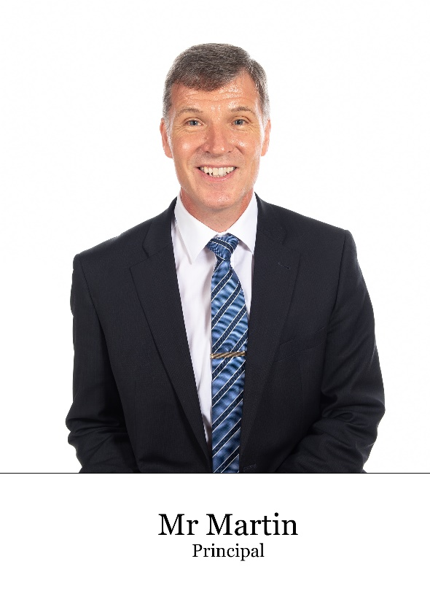
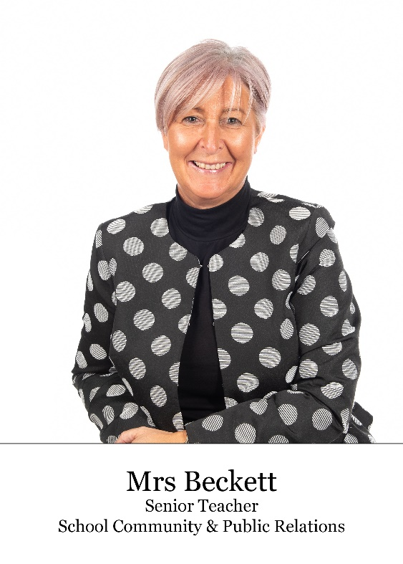

Slide 7
Illness & Appointments
Pupils to go to Form Tutor
If your child contacts you saying they feel unwell, please tell them to ask to see their form tutor
Medication – please contact your child’s form tutor if they require any specific medication to be kept in school
Appointments – send a note to school on the day before/day of the appointment. If possible, please schedule these outside of school hours

Slide 8
Attendance
Parents must send a note to school detailing reason for absence so this can be recorded on students’ attendance record.
Form tutors will contact you if a student has been absent for more than 3 consecutive days.
Holidays during term time are strongly discouraged

Slide 10
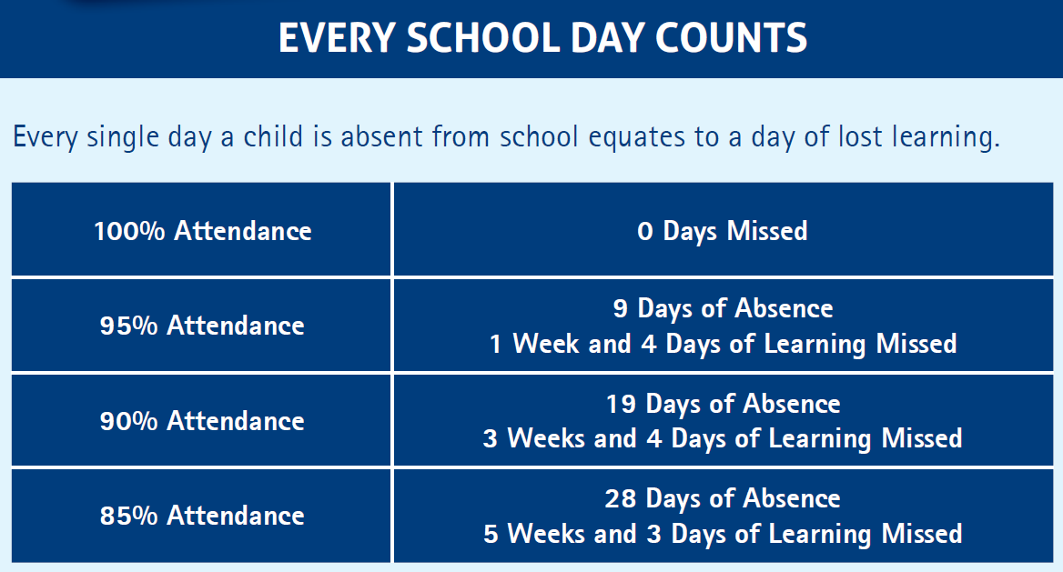

Slide 11
Counselling

Slide 12
Home-School Links
Text Message
Email
Phonecall
SIMS App
Parent Consultations

Slide 13
Home-School Links
Please do not contact the college via our social media pages, all enquiries should be made via the college office on 02892607351.
If you need to speak a member of staff, please make an appointment.
Please be aware the staff are teaching from 9am -3pm.

Slide 14
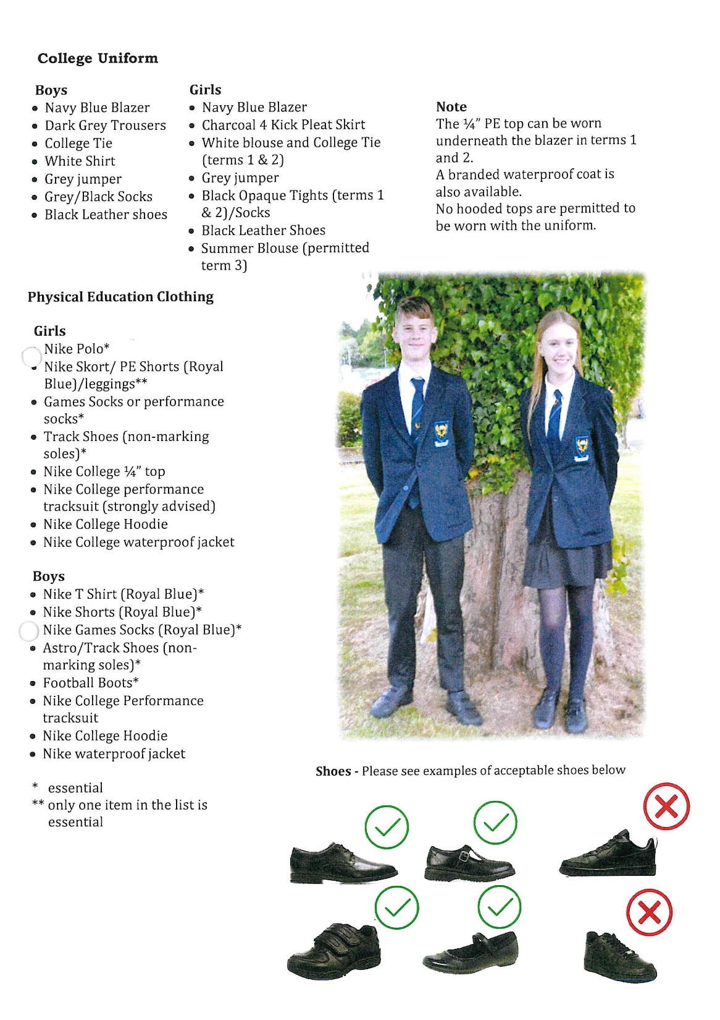

Slide 15
Teaching & Learning at Laurelhill

Slide 16
Encouraging Independent Learners
Students should come to school ready to learn with the correct equipment for each day
Please encourage students to pack their school bag each night for the day ahead, students do not need to carry all of their books all of the time
Ensure PE kit/equipment is brought to school on the day it is required. Students should not wear their PE kit to college

Slide 17
Importance of Parental Support
Parents also play a vital role in supporting their children. The evidence shows that parental interest and encouragement is a strong predictor of a child’s success in education and their career.

Slide 18
Supporting your Child’s Education
Attendance and time keeping.
Personal Organisation, routine and planning to succeed.
Home study environment
Readiness to learn and work ethic
Sleep, exercise, diet and routine
Life experience and extra curricular

Slide 20
Year 8 Assessment
Online Testing
Winter Assessments/Exams – Tracking 1
Tracking Assessments – Tracking 2
Summer Exams – Tracking 3

Slide 21
Online Testing
At the start of Year 8, all students will complete the following assessments:
PTE (Progress Test in English)
PTM (Progress Test in Maths)
CAT4 (3 tests to be completed and results are used to inform individual and group teaching, for target setting and monitoring the performance of groups of students)
PASS (focusing on three broad areas – how a student feels about themselves, their engagement with the curriculum, and their feelings about school.)

Slide 22
Online Testing
End of September 2023
Students should bring a set of headphones to school for online testing

Slide 23
Winter Report
This will be based on the online testing
It will be shared at the end of October via the SIMS app

Slide 24
Winter Assessments – Term 1
First set of examinations students will complete, known as ‘Tracking 1’
Thursday 16th November 2023 – Wednesday 22nd November 2023, they will take place in subject classes
Some assessments in practical subjects such as Art, ICT, Music and Drama may happen 1-2 weeks before the date above. Their class teacher will inform them of these dates
Subject teachers will provide revision lists for these assessments

Slide 25
Tracking 2 – Term 2
These assessments take place in the classroom between the 10th January and the 28th February
Tracking 2 will be classroom based tasks, there will not be a formal assessment week
Individual subjects will inform students what these tasks are, and how and when they will be assessed

Slide 26
Summer Exams – Term 3
Formal examination week – ‘Tracking 3’
Students complete exams in a specific exam room
Normal timetable will be ‘collapsed’ and an examination timetable provided for students to follow
The experience prepares students for GCSE
Summer Exams will run 28th May 2024 – 31st May
2024

Slide 27
Summer Report
The summer report includes scores from the summer examination period and written comments from subject teachers and form tutor
These reports are shared electronically via the SIMS app
A colour coded system of red, amber and green is used to indicate if a student is above, below or on target

Slide 28
Reporting Cycle and Parent Interview
Base Data Report – End of October
1
SIMS app
Parent Afternoon – 19th February 2023
2
Online using School Cloud
Summer Written Report – End of June
3
SIMS app

Slide 29
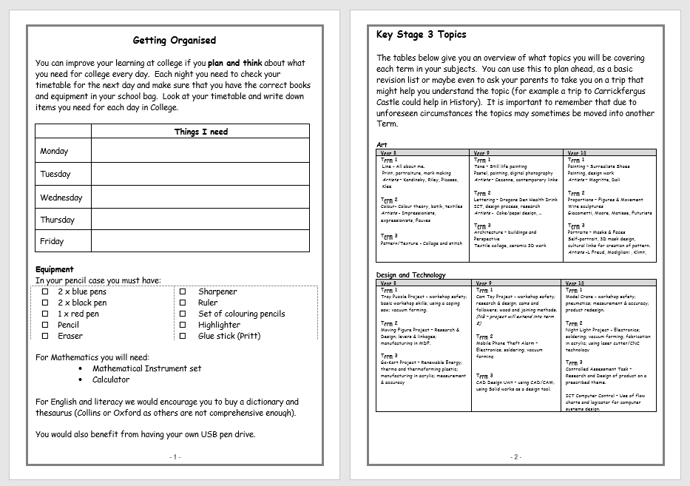
Student Planner

Slide 30
Homework
The student planner or homework diary has many areas to help support students to manage their time and get organised
We encourage students to write their homework into their diaries on the day a task is due to be submitted
Students must complete and hand in all homework set

Slide 31
Homework Planner
Good way to communicate with your child’s form tutor
- absence notes
- a quick message
We encourage all parents to monitor their child’s homework diaries. They should be signed every week by parents and form tutors
Please check students are recording their homework – if a student requires further support then please inform their form tutor.

Slide 32
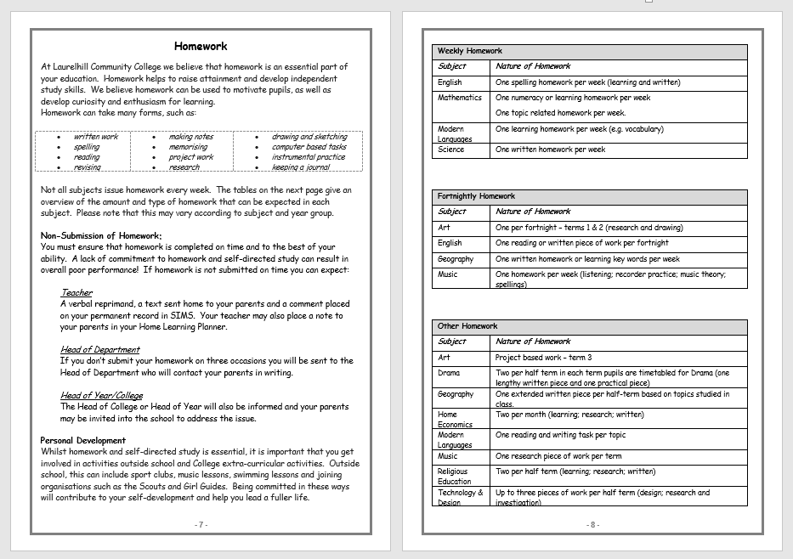
Homework and Home Study

Slide 33
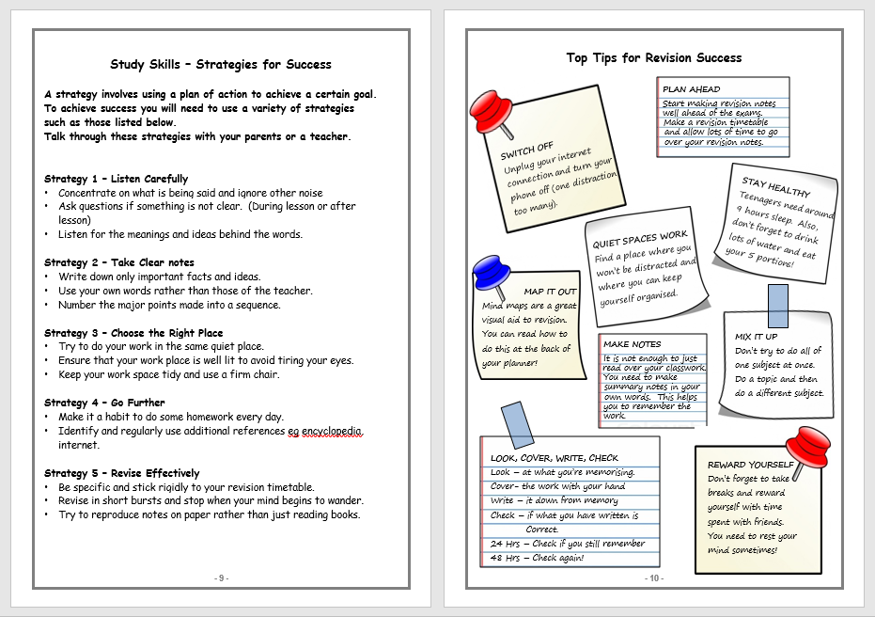
Home Study and Revision

Slide 34
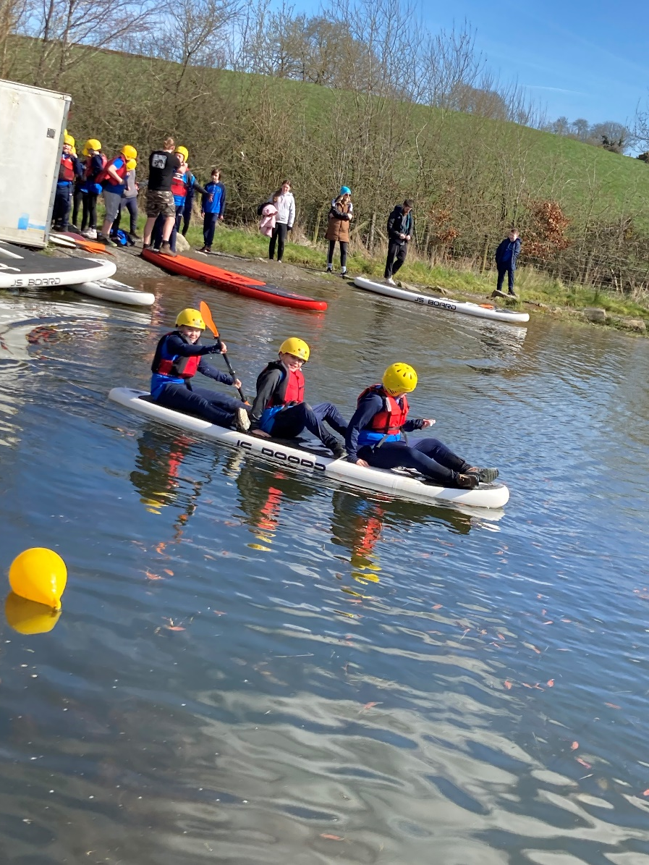
Lurgaboy Adventure Centre
As part of our transition programme
we have booked an activity day at
Lurgaboy Adventure Centre in
Armagh for our Year 8 students
Students will participate in a range of
outdoor activities such as orienteering,
archery, paddle boarding and team
building games
The cost of the trip is £15, this will be
requested via the school money app.
Students will receive a consent form
which must be completed and returned
to school in order to attend.

Slide 35
Success does not happen by accident. It is planned for!
Working in partnership is crucial in giving our children the best chance of success!

